Slide 1
International Management

Slide 2
Learning Objectives
Explain how globalization affects organizations
Describe major regional trading alliances
Understand the three major legal systems used
Understand and define culture
Understand the four major religions in the world

Slide 3
Globalization
Globalization is the broadening interdependence among people from all parts of the world.
What benefits do organizations realize from embracing globalization?

Slide 4
Are You Ready To Work Internationally?
Cross-cultural skills are extremely important
Every manager needs to think globally
The future of business and society is being shaped by global relationships
A global mind-set is becoming a prerequisite for managers

Slide 5
A Borderless World
Isolation from international forces is no longer possible
Trade barriers are falling
Communication is faster and cheaper
Consumer tastes are converging
Virtual connections enable close, rapid coordination among people working in different parts of the world

Slide 6
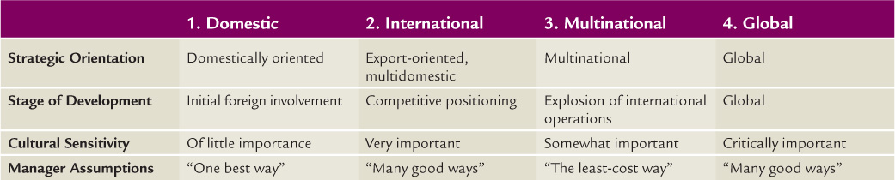
Four Stages of Globalization

Slide 7
Imports and Exports
Import
Export
A firm buying a product from a foreign nation.
A trade deficit occurs when a nation imports more than it exports.
A firm selling a product to a foreign nation.
A trade surplus occurs when a nation exports more than it imports.

Slide 8
Strategies for Entering International Markets
Exporting – transfers products for sale in foreign countries
Global Outsourcing – transferring the labor of specific tasks to low cost countries
Licensing – allowing an operation in another country to produce and sell company products
Franchising – providing a foreign organization with package of materials and services
Direct Investing - a production facility in another country

Slide 9
What do you think?
Is globalization helping some groups while hurting others?
Would individuals be better off without globalization?

Slide 10
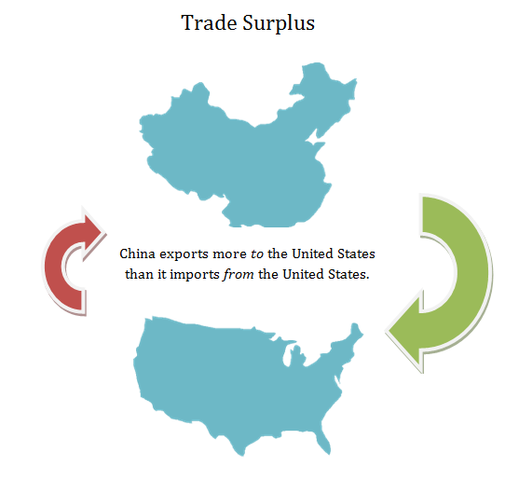

Slide 11
Regional Trading Alliances
North American Free Trade Agreement (NAFTA)
Trade between U.S. and Canada occurred at rates two times faster than prior to NAFTA
European Union (EU)
EU also has its own currency, the Euro
China-ASEAN Free Trade Area

Slide 12
What do you think?
Even though Mexico, Canada, and the United States are members of NAFTA, each country has its own currency. Most members of the European Union have adopted a common currency, the Euro.
What benefits do countries receive from a common currency? Are there any potential problems with this?

Slide 13
Legal Systems
Common Law
Very few rules or statutes
Courts wrote opinions explaining decisions
Civil Law
Uses statutes to form legal judgments
Theocratic Law
Based on religious teachings
Subject to individual interpretation

Slide 14
Culture
Includes the collective set of norms, ideas, beliefs, and ways of thinking of a group of individuals.
Culture can vary by community, city, state, and country.
Elements of culture include language, food preferences, customs, and beliefs.

Slide 15
YouTube Video
Why is it important to be aware of the culture in a region?
Culture Shock and International Business

Slide 16
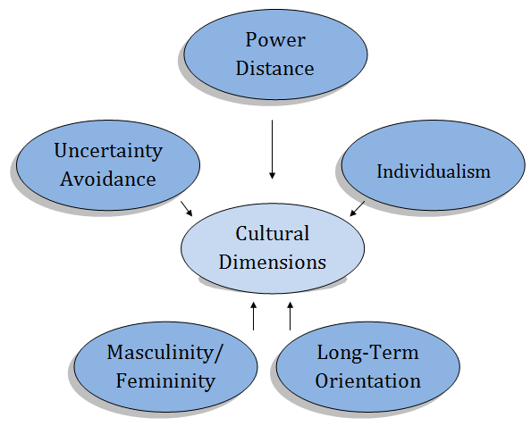
Hofstede’s Cultural Dimensions

Slide 17

Power Distance
Power distance refers to the extent to which less powerful members within a country expect and accept that power is distributed unequally.
Countries will a low power distance dimension believe inequality in society should be minimized.

Slide 18
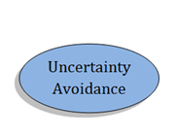
Uncertainty Avoidance
Uncertainty avoidance refers to the extent to which a culture accepts or avoids ambiguous situations and uncertainty.
Countries with low uncertainty avoidance believe in as few rules as possible, experience lower stress, and take each day as it comes.

Slide 19
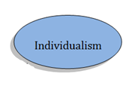
Individualism & Collectivism
Individualism refers to the idea that an individual’s identity is fundamentally his or her own. “Rugged Individualism”
Collectivism contends that an individual’s identity is tied to his or her collective group.
Collectivism suggests a preference for a tightly knit social framework.

Slide 20
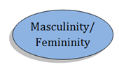
Masculinity and Femininity
The masculinity dimension stands for preference for achievement, heroism, assertiveness, and material success.
Femininity reflects the values of relationships, cooperation, group decision-making and quality of life.

Slide 21
Religion
Hinduism
No set rule of laws, scriptures or code
Most practitioners believe in karma and reincarnation
Buddhism
Founded by Siddartha Guatama
Teaches people how to attain release from being bound to this world

Slide 22
Religion (cont’d)
Islam
Founded by Muhammad
Literally means submission or surrender
Christianity
Jesus Christ is central figure
Major Christian organizations include the Roman Catholic Church and the Eastern Orthodox Church

Slide 23
Review
What effect can different cultures have on international business?
Is it important to understand different cultures and religions when corresponding with others? Why?
How do trading alliances benefit member countries?

